Slide 1

MRA Project – Milestone 1
Soorej Kunnool BALAN
PGDSBA–Jun(B) ’22 BATCH

Slide 2
Agenda[Table of Contents]
Problem Statement
Tools Used
Executive Summary of data
EDA (Exploratory Data Analysis)
Univariate Analysis
Bivariate/Multivariate (BV/MV) Analysis
Sales Trends
Sales across Categories
Inference
Customer Segmentation – RFM Analysis
What is RFM?
Parameters & Assumptions
KNIME workflow image
RFM Output Table head
Inferences from RFM Analysis and identified segments
Best customers
Customers on the verge of churning
Lost customers
Loyal customers

Slide 3
Problem Statement
An automobile parts manufacturing company has collected data of transactions for 3 years. They do not have any in-house data science team; thus, they have hired you as their consultant. Your job is to use your magical data science skills to provide them with suitable insights about their data and their customers.
Auto Sales Data →
Data Dictionary
Excel Column Name | Definition
ORDERNUMBER | Order Number
QUANTITYORDERED | Quantity Ordered
PRICEEACH | Price of Each Item
ORDERLINENUMBER | Order Line
SALES | Sales Amount
ORDERDATE | Order Date
DAYS_SINCE_LASTORDER | Days Since Last Order
STATUS | Status of Order (Shipped etc.)
PRODUCTLINE | Product Line – Category
MSRP | Manufacturer’s Suggested Retail Price
Excel Column Name | Definition
PRODUCTCODE | Code of Product
CUSTOMERNAME | Customer
PHONE | Phone of the Customer
ADDRESSLINE1 | Address of the Customer
CITY | City of the Customer
POSTALCODE | Postal Code of the Customer
COUNTRY | Country of the Customer
CONTACTLASTNAME | Contact Person’s Last Name, of the Customer
CONTACTFIRSTNAME | Contact Person’s First Name, of the Customer
DEALSIZE | Size of the deal based on Quantity & Item Price

Slide 4
Tools Used
We will be analyzing the data using python, KNIME analytics platform and Tableau software.
The link for the Tableau workbook is given below:
https://public.tableau.com/app/profile/soorej.balan/viz/MRA_RFM_Project/UV-Sales
The Jupyter(python) notebook and KNIME workflow is attached with this ppt for submission.

Slide 5
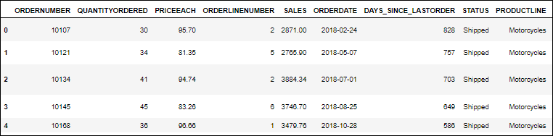
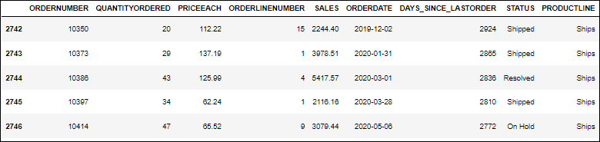
Executive Summary of Data
Tool – Used python to determine executive summary of data.
Data Head (First 5 rows) Data Tail (Last 5 rows)
Dataset Shape – Data has 2747 rows and 20 columns.
Null Values - There are no null/missing values in the dataset.
Duplicate Records – There are no duplicate records in the dataset.

Slide 6
Executive Summary of Data
Tool – Used python to determine executive summary of data.
Data Head (First 5 rows) Data Tail (Last 5 rows)
Dataset Shape – Data has 2747 rows and 20 columns.
Null Values - There are no null/missing values in the dataset.
Duplicate Records – There are no duplicate records in the dataset.

Slide 7
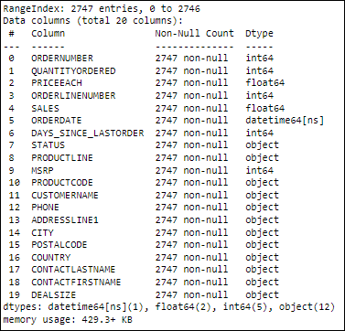
Executive Summary of Data (contd..)
Concise Data Summary:
The concise data summary shows the presence of
2747 rows and 20 columns.
We can see that the data columns are of the following
data types.
Datetime datatype: ORDERDATE
Float Datatype: PRICEEACH, SALES
Integer Datatype: ORDERNUMBER, QUANTITYORDERED,
ORDERLINENUMBER, DAYS_SINCE_LASTORDER, MSRP
Object Datatype: STATUS, PRODUCTLINE, PRODUCTCODE,
CUSTOMERNAME, PHONE, ADDRESSLINE1, CITY,
POSTALCODE, COUNTRY, CONTACTLASTNAME,
CONTACTFIRSTNAME, DEALSIZE

Slide 8
Executive Summary of Data (contd..)
Assumptions
Since there are no nulls or duplicate in the data, it seems the data is accurate.
We will include the outliers and not treat them unless they exceed 3*IQR from the median.
We can perform univariate, bivariate and multivariate analysis on the data.
Sales and order date information can give us weekly, monthly and yearly trends
We seem to have sufficient data for RFM Analysis.
Recency can be determined as the max of the order date – max of the customer’s order date.
Frequency can be determined by taking the unique count of customer’s order number.
Monetary value of each order line is given by Sales.

Slide 9
EDA
For exploratory data analysis we will use Tableau for the visual charts with the input dataset.
We will start with univariate analysis of numeric variables to understand the mean values, distribution, range etc.
Order and Order line number we won't perform univariate analysis as they are nominal in nature.
Univariate analysis will be performed on categorical variables, such as Status, Product Line etc and not on variables such as AddressLine1 which are nominal.
This will be followed by bivariate analysis of categorical and numeric columns and multivariate analysis.
Then we will move onto the Sales trends based on order date, followed by the impact of Sales due to the available categorical fields.
We will wrap the EDA section with inference gained through the above steps.

Slide 10
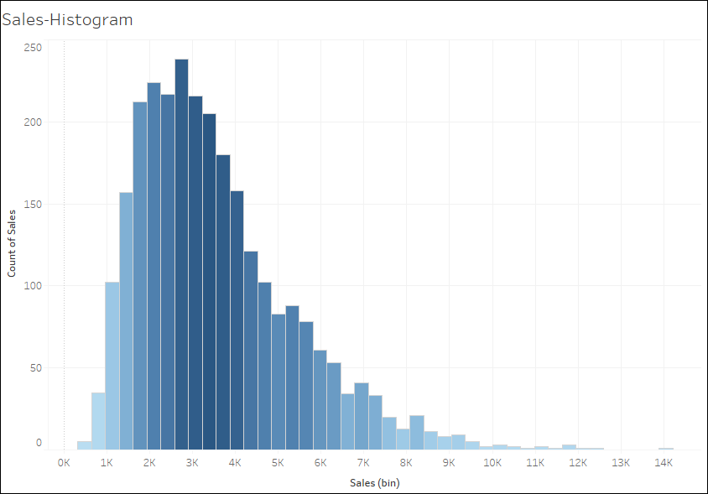
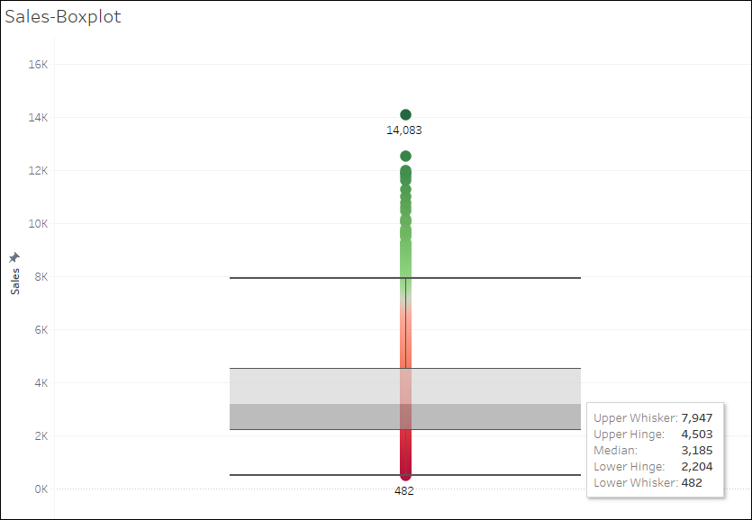
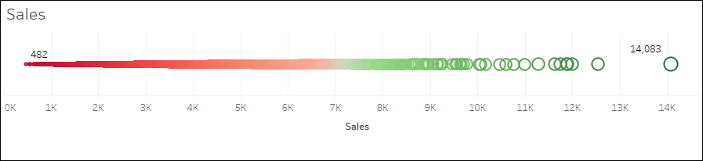
EDA – Univariate Analysis - SALES
Using python, we get the following measures of central tendency for SALES, which is a continuous column.
From tableau we can see that graph corroborates the above values from python. We can see that sales range from 482 to 14,083 with mean value of 3553 and median 3185. Outliers are present in boxplot and is expected and we will not treat them. Histogram shows
right skew.

Slide 11
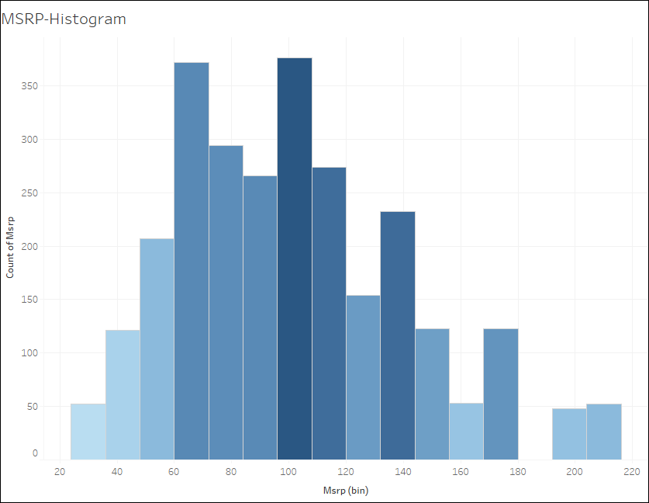
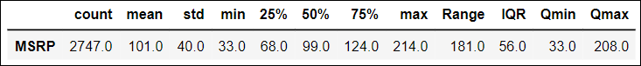
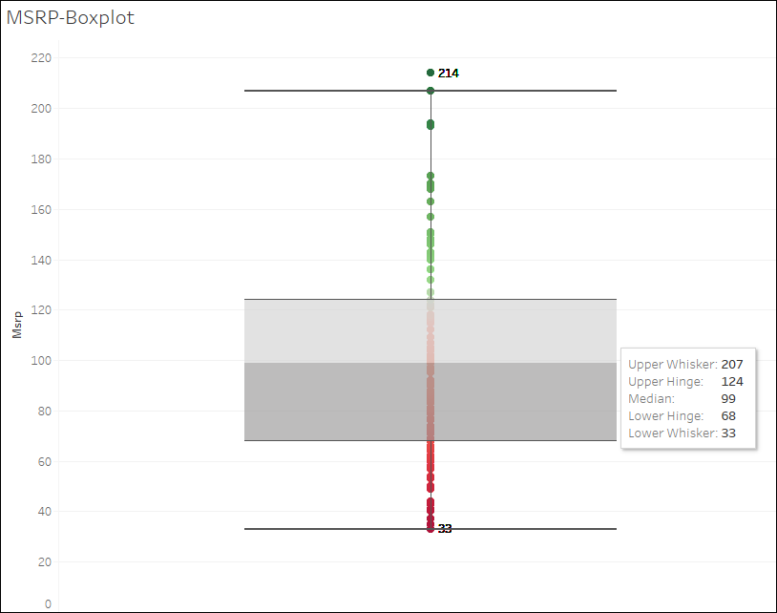
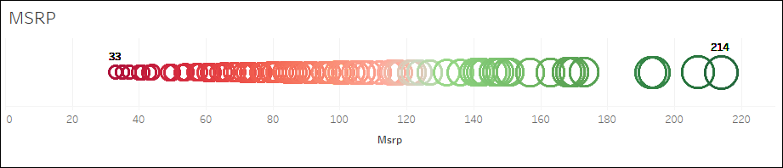
EDA – Univariate Analysis - MSRP
Using python, we get the following measures of central tendency for MSRP, which is a continuous column.
From tableau we can see that graph corroborates the above values from python. We can see that MSRP range from 33 to 214 with mean value of 101 and median 99. One outlier is present in boxplot and is expected and we will not treat them. Histogram shows slight
right skew.

Slide 12
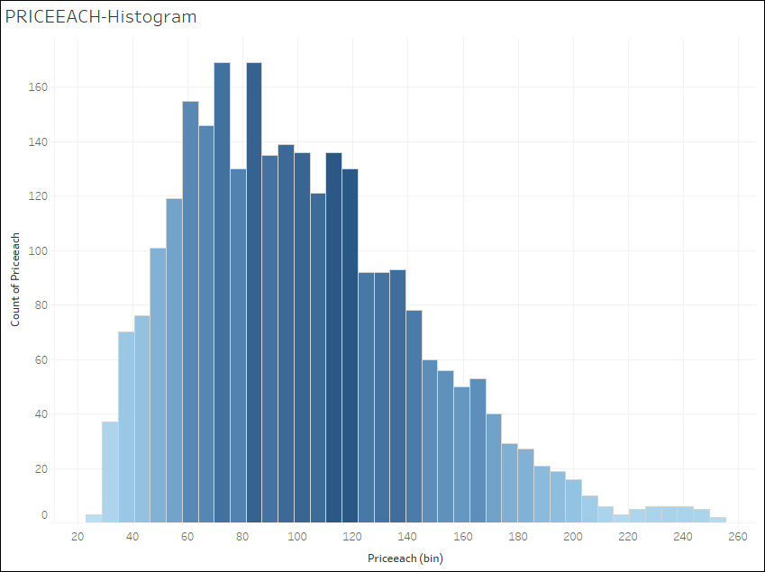
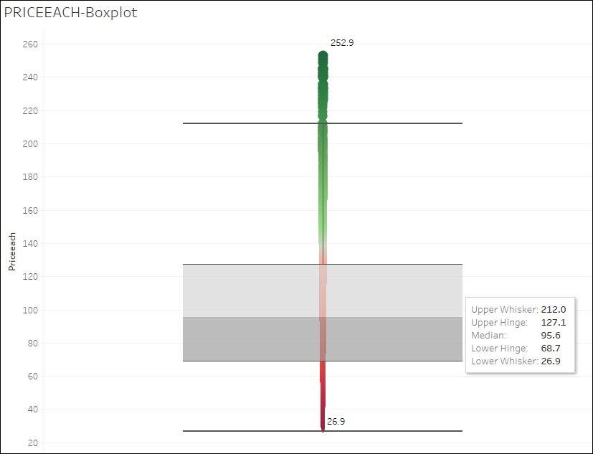
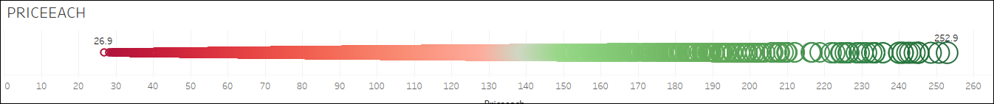
EDA – Univariate Analysis - PRICEEACH
Using python, we get the following measures of central tendency for PRICEEACH which is a continuous column.
From tableau we can see that graph corroborates the above values from python. We can see that PRICEEACH range from 27 to 253 with mean value of 101 and median 96. Outliers are present in boxplot and is expected and we will not treat them. Histogram shows right skew.

Slide 13
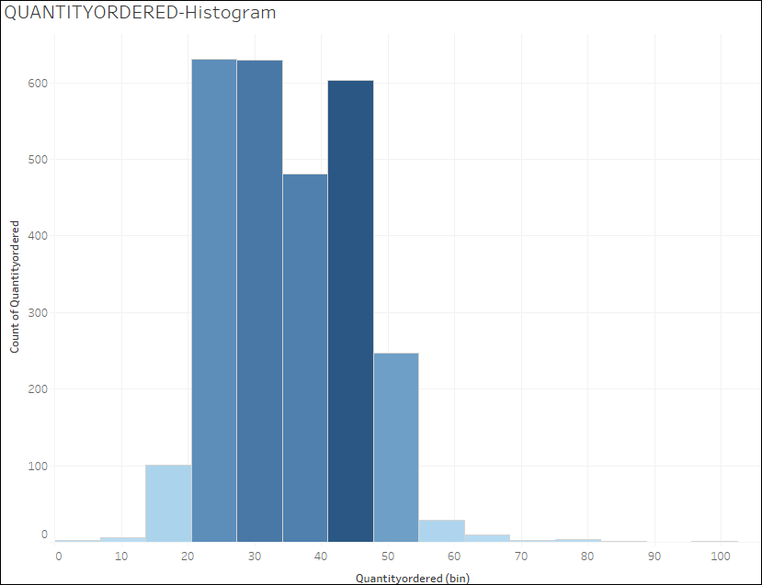
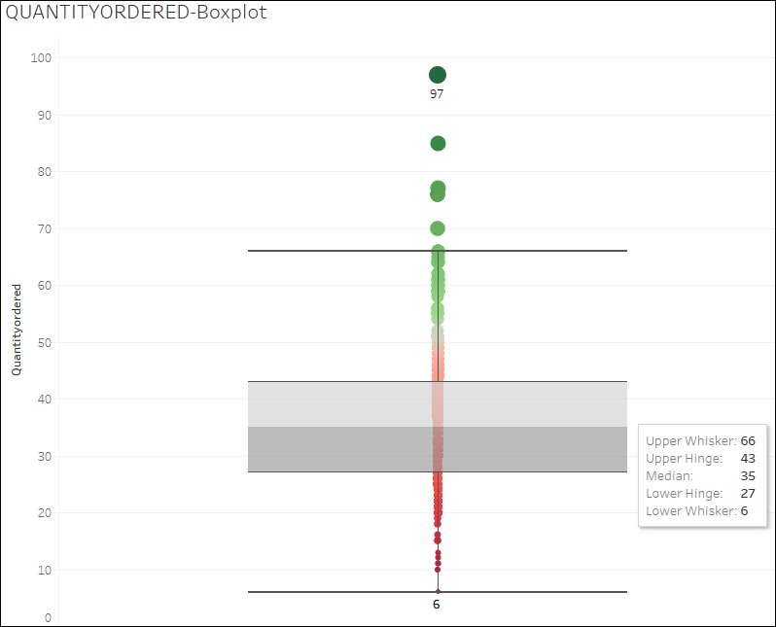
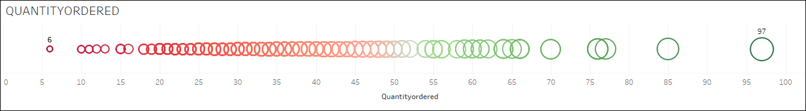
EDA – Univariate Analysis - QUANTITYORDERED
Using python, we get the following measures of central tendency for QUANTITYORDERED which is a continuous column.
From tableau we can see that graph corroborates the above values from python. We can see that QUANTITYORDERED range from 6 to 97 with mean value and median 35. Outliers are present in boxplot and is expected and we will not treat them. Histogram shows slight right skew.
13

Slide 14
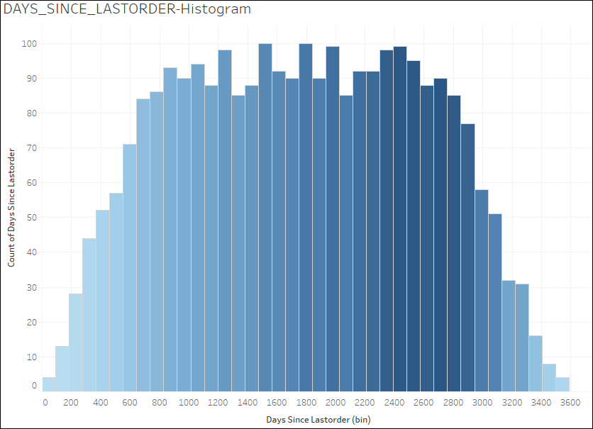
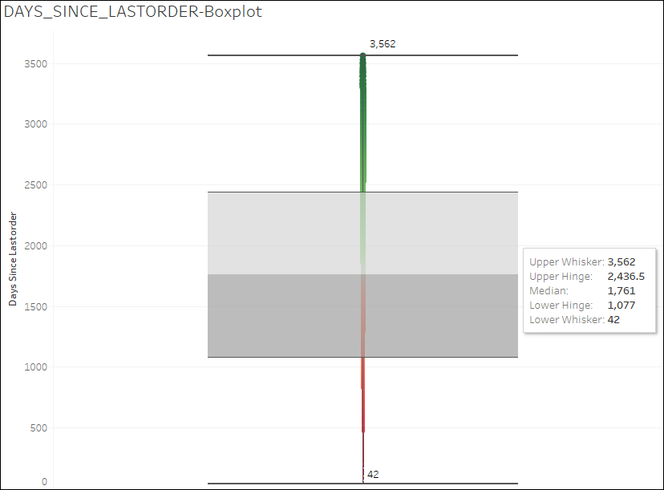
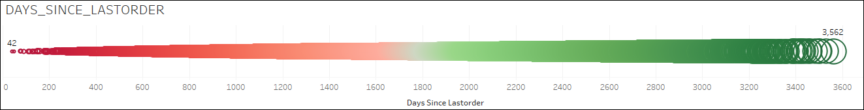
EDA–Univariate Analysis -DAYS_SINCE_LASTORDER
Using python, we get the following measures of central tendency for DAYS_SINCE_LASTORDER which is a continuous column.
From tableau we can see that graph corroborates the above values from python. We can see that DAYS_SINCE_LASTORDER range from 42 to 3562 with mean value 1757 and median 1761. Outliers are present in boxplot and is expected and we will not treat them. Histogram looks to be normally distributed.
14

Slide 15
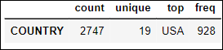
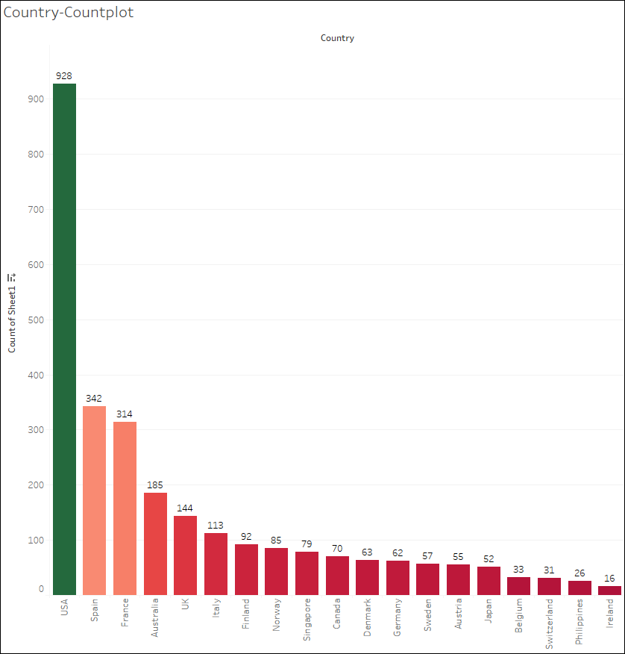
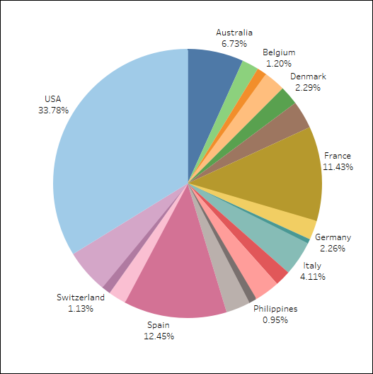
EDA–Univariate Analysis -COUNTRY
Using python, we get the following measures of central tendency for COUNTRY which is a categorical column.
From tableau we can see that graph corroborates the above values from python. We can see that there are 19 countries from which customers have placed orders. USA, Spain and France lead on the number of order lines with 928, 342 & 314 (33.78%,12.45% and 11.43%) respectively. The bottom 3 countries with least number of orderliness ae Switzerland, Philippines & Ireland with values of 31, 26 & 16 (1.13%, 0.95%,0.58%) respectively.
15

Slide 16
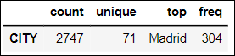
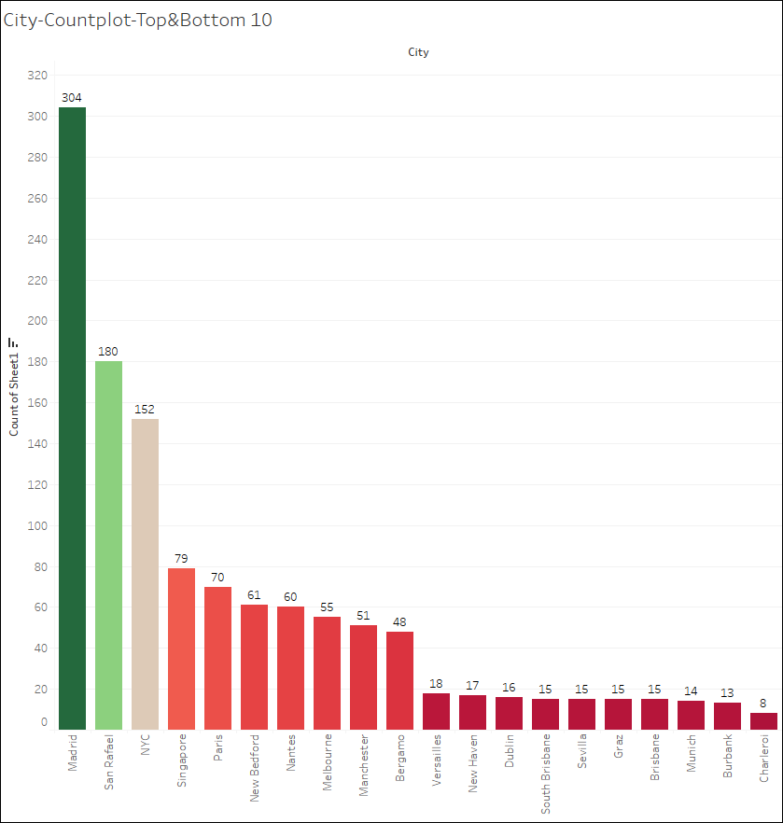
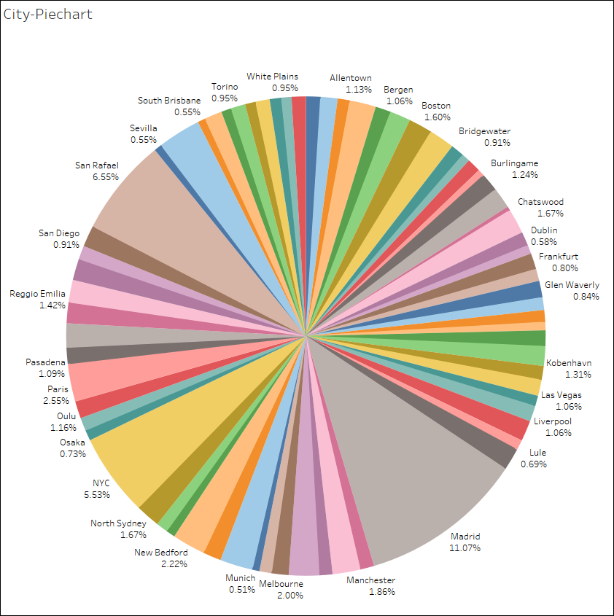
EDA–Univariate Analysis -CITY
Using python, we get the following measures of central tendency for CITY which is a categorical column.
From tableau we can see that graph corroborates the above values from python. We can see that there are 71 cities with Madrid having the highest number of frequency at 304. The below Countplot shows the top 10 and bottom 10 cities in terms of number of order lines. We can see that Madrid, San Rafael and NYC are the top 3 cities with 304,180,152 (11.07%,6.55%,5.53%) orderliness respectively and Munich, Burbank and Charleroi are the bottom 3 cities with 14,13,8 (0.51%,0.47%,0.29%) order lines respectively.
16

Slide 17
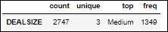
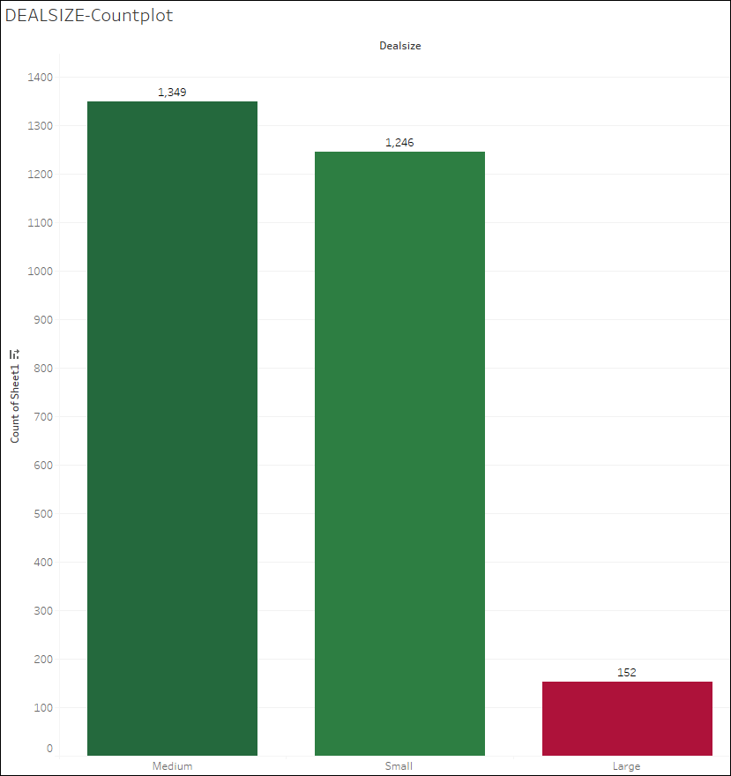
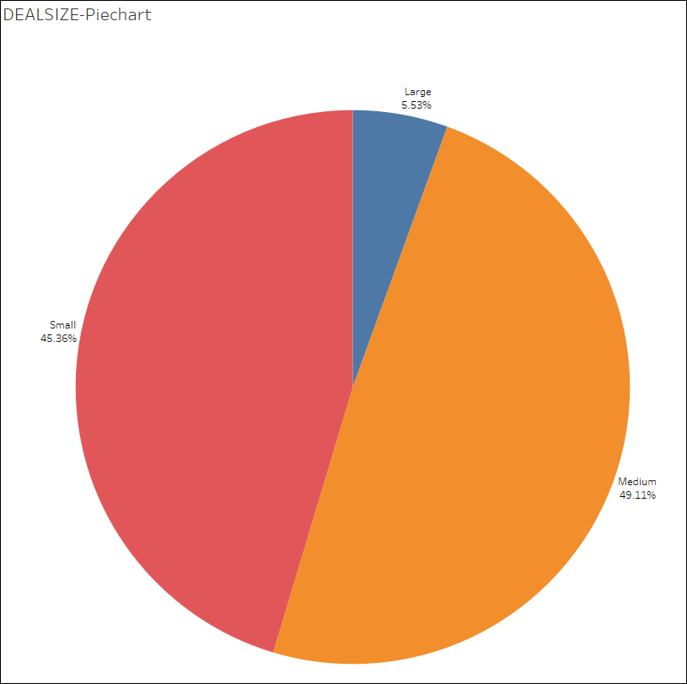
EDA–Univariate Analysis -DEALSIZE
Using python, we get the following measures of central tendency for DEALSIZE which is a categorical column.
From tableau we can see that graph corroborates the above values from python. We can see that there are 3 deal types with Medium having maximum frequency of 1349 (49.11%), followed by Small with frequency of 1246 (45.36%) and Large with frequency of 152 (5.53%). The below Countplot and pie chart shows the distribution.
17

Slide 18
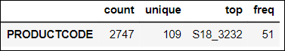
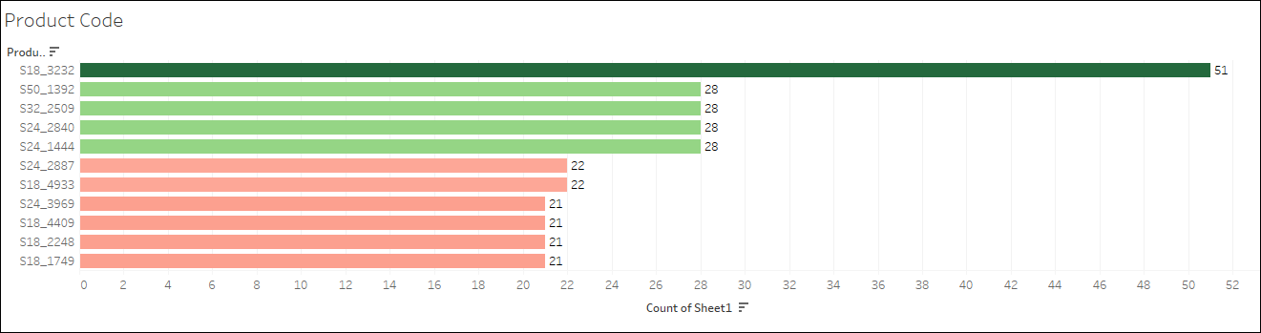
EDA–Univariate Analysis -PRODUCTCODE
Using python, we get the following measures of central tendency for PRODUCTCODE which is a categorical column.
From tableau we have plotted the top 5 and bottom 5 product code w.r.t frequency. Product S18_3232 has the highest frequency with 51 and we have about 4 products(for e.g. S18_1749) with least frequency of 21. If we disregard the top product S18_3232, all the other 108 product codes vary in frequency between 21 and 28, which can be considered same. Hence, we can surmise that most product codes (apart from S18_3232) are ordered by the customer base within similar frequency.
18

Slide 19
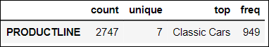
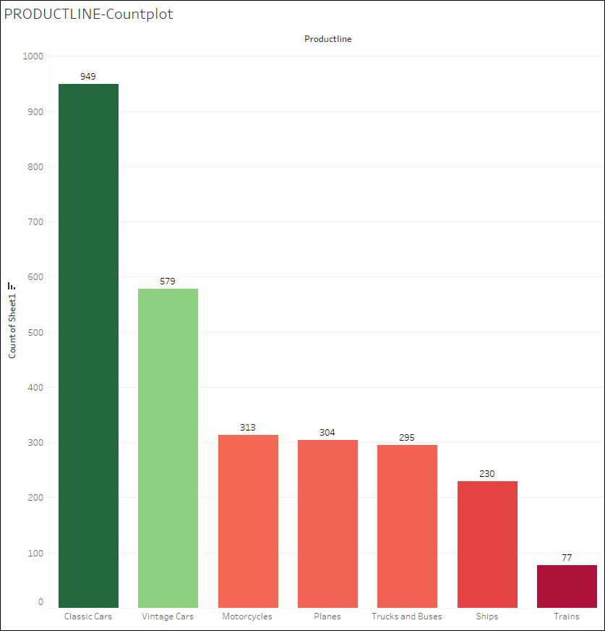
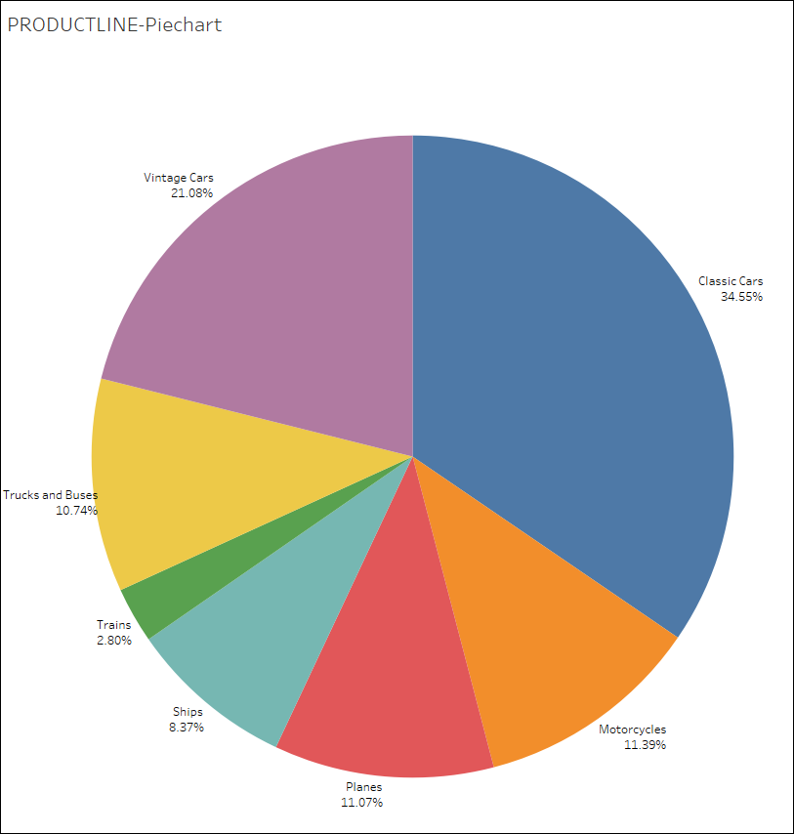
EDA–Univariate Analysis -PRODUCTLINE
Using python, we get the following measures of central tendency for PRODUCTLINE which is a categorical column.
From tableau we can see that graph corroborates the above values from python. We can see that there are 7 product lines and Classic Cars have the highest frequency of 949 (34.55%). Trains are the product line with least frequency – 77 (2.8%).
19

Slide 20
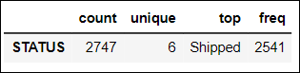
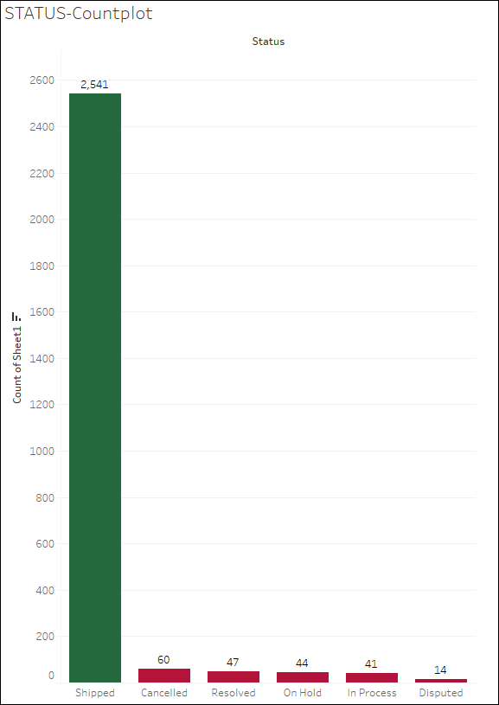
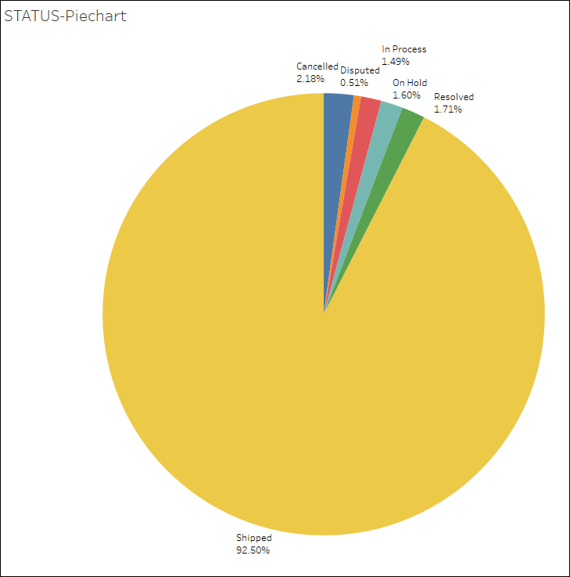
EDA–Univariate Analysis -STATUS
Using python, we get the following measures of central tendency for STATUS which is a categorical column.
From tableau we can see that graph corroborates the above values from python. We can see that there are 6 Status category and Shipped have the highest frequency of 2741 (34.55%). Disputed status have the least frequency – 14 (0.51%).
20

Slide 21
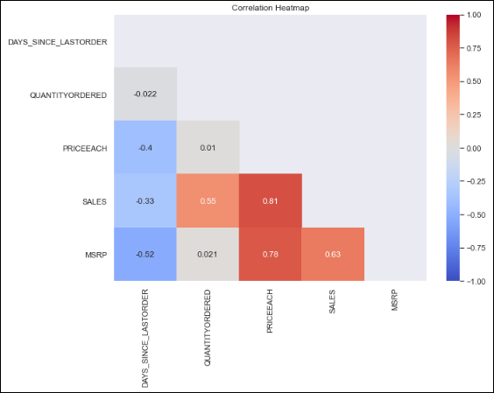
EDA–BV/MV Analysis-Correlation Heatmap
Using python, we get the correlation heatmap of numeric columns.
We can see strong positive correlation between SALES, PRICEEACH & QUANTITYORDERED, which stands to reason as SALES is calculated from PRICEEACH & QUANTITYORDERED.
We can see strong correlation between MSRP and PRICEEACH (normal market behavior), which in turn leads to strong correlation between MSRP and SALES.
We can see moderate negative correlation between DAYS_SINCE_LAST_ORDER & MSRP/SALES & PRICEEACH. This indicates that customers which make big purchases are less recent.
QUANTITYORDERED shows almost no correlation with PRICEEACH/MSRP which indicates that the market is stable, and customers are not stocking items, expecting prices to be varied.
21

Slide 22
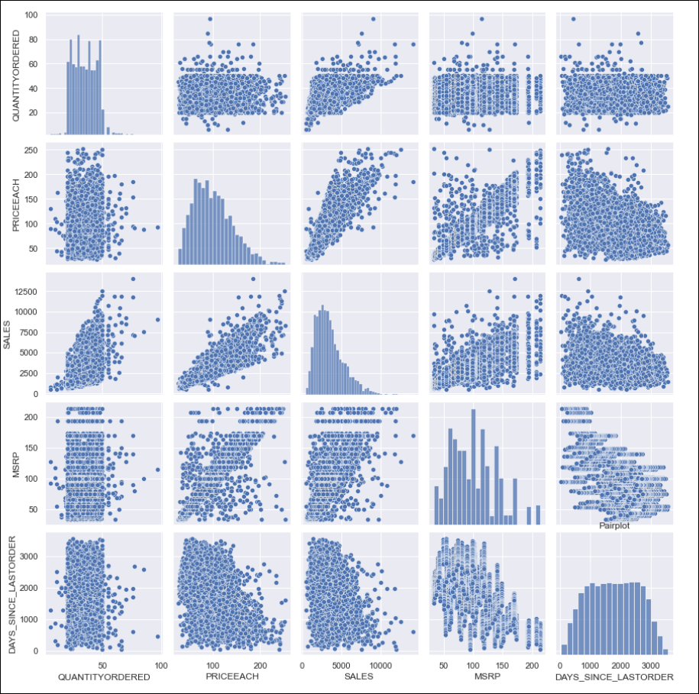
EDA–BV/MV Analysis-Pairplot
Using python, we get the Pairplot of numeric columns.
It corroborates the findings from correlation heatmap.
Strong positive correlation between SALES, PRICEEACH & QUANTITYORDERED
Strong correlation between MSRP and PRICEEACH which in turn leads to strong correlation between MSRP and SALES.
Moderate negative correlation between DAYS_SINCE_LAST_ORDER & MSRP/SALES & PRICEEACH.
QUANTITYORDERED shows almost no correlation with PRICEEACH/MSRP.
22

Slide 23
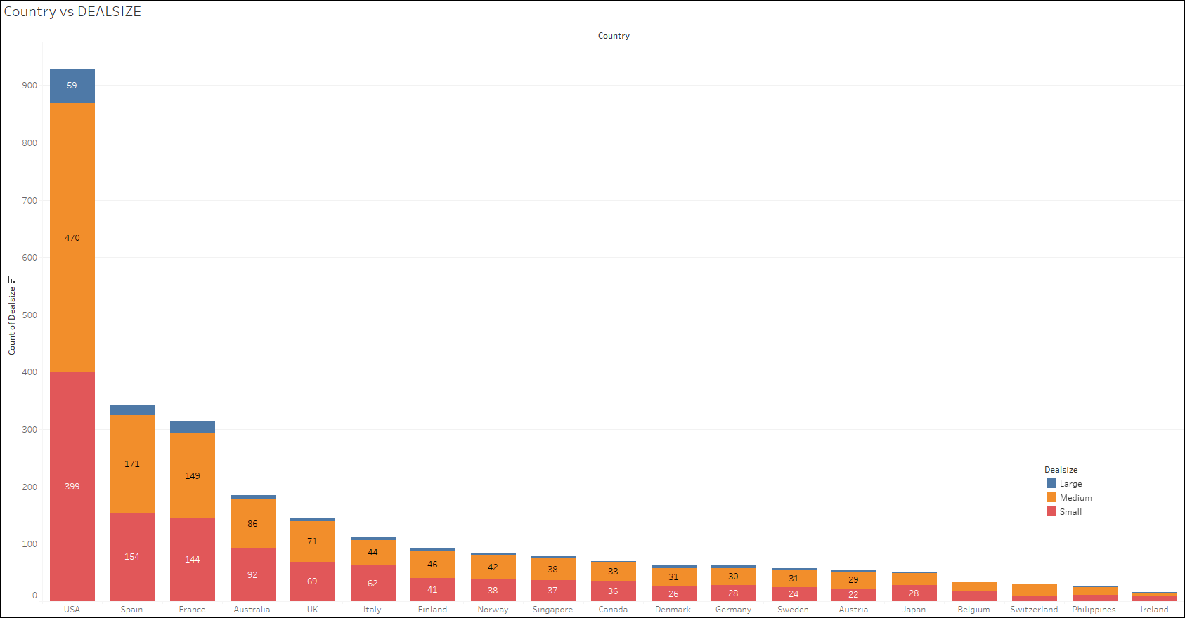
EDA–BV/MV Analysis-Country vs DEALSIZE
Using Tableau, we derive a stacked bar chart of Country vs DEALSIZE.
In all three types of dealsize –large/medium & small , USA leads in count, followed by Spain and then France ( France(21) has more large deals than Spain – (17)).
Switzerland Philippines & Ireland are at the bottom of the table when considering number of deals.
23

Slide 24
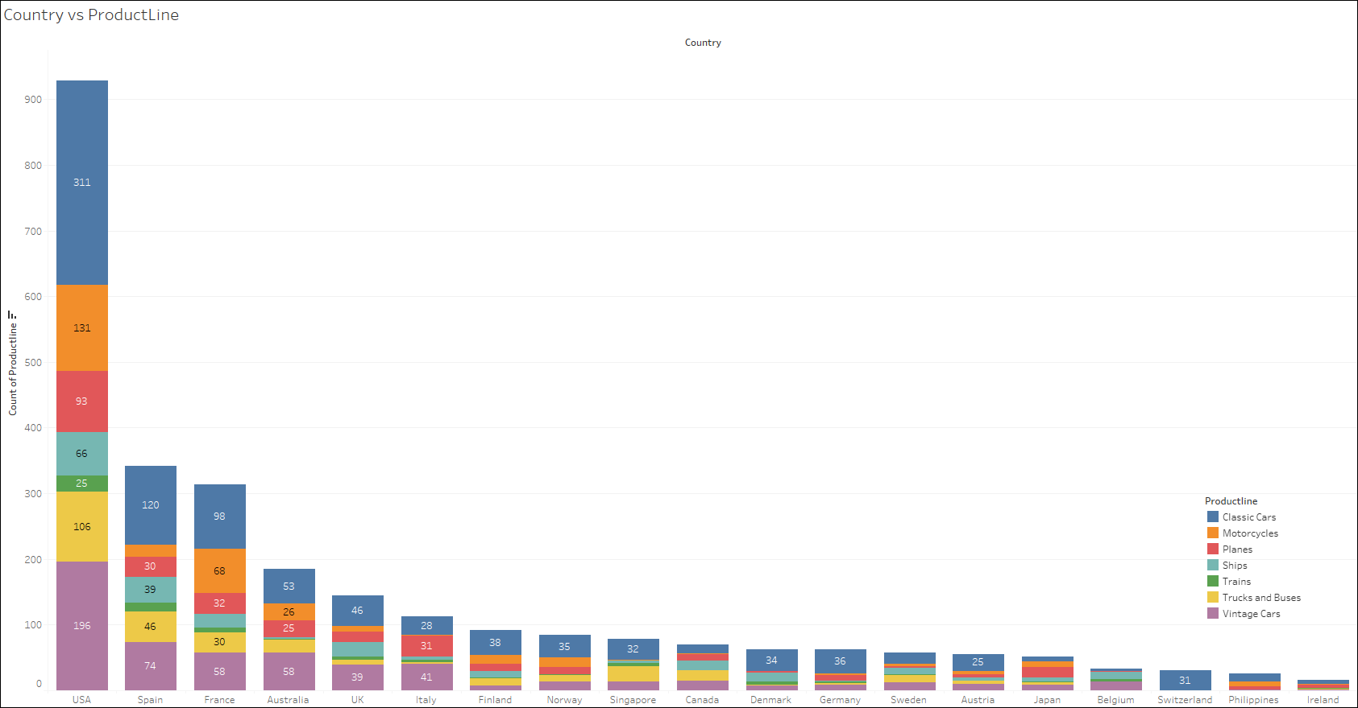
EDA–BV/MV Analysis-Country vs PRODUCTLINE
Using Tableau, we derive a stacked bar chart of Country vs PRODUCTLINE.
In the top 3 countries with maximum order, we can see that the top 3 product lines are Classic Cars, Vintage Cars and Motorcycles.
24

Slide 25
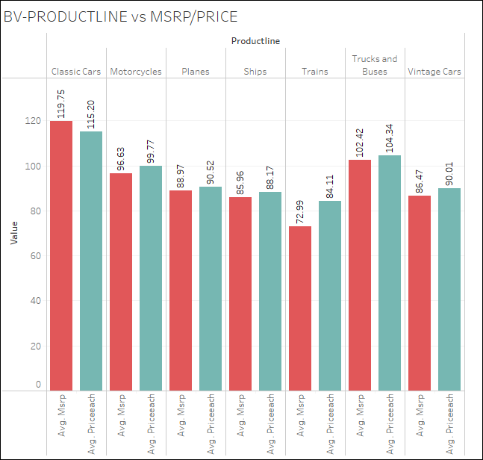
EDA–BV/MV Analysis-MSRP/PRICE vs PRODUCTLINE
Using Tableau, we derive the average MSRP and PRICE of products across the product line.
MSRP and PRICEEACH variable follows the same behavior across the productline.
The average price is highest for Classic cars, followed by Trucks & Buses and then by Motorcycle.
MSRP follows the same pattern, but we have PRICEEACH higher than MSRP for all productlines except Classic Cars.
25

Slide 26
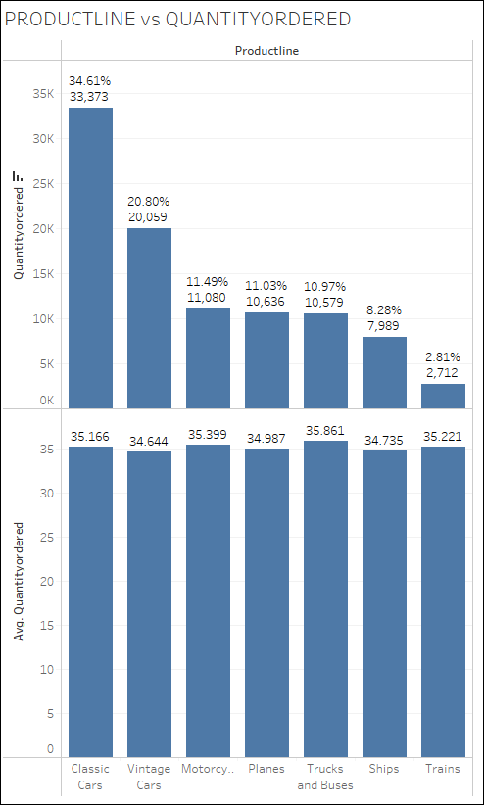
EDA–BV/MV Analysis-QUANTITYORDERED vs PRODUCTLINE
Using Tableau, we derive the average and sum of QUANTITYORDERED across the product line.
We can see that the average quantity per order across the productline same around 35.
Across the dataset we have customers ordering the productline Classic Cars maximum at 33,373 (34.61%), followed by Vintage Cars at 20,059 (20.8%) and then 11,080 (11.49%).
26

Slide 27
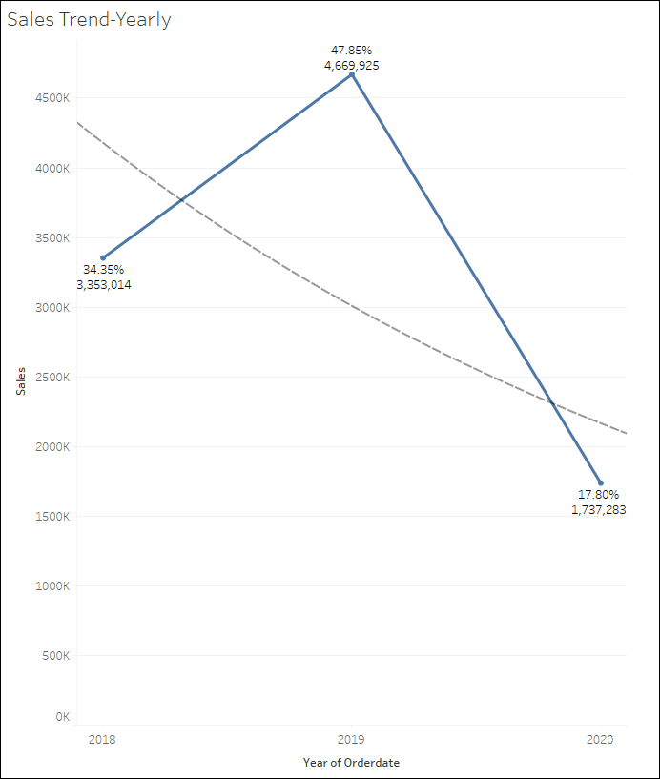
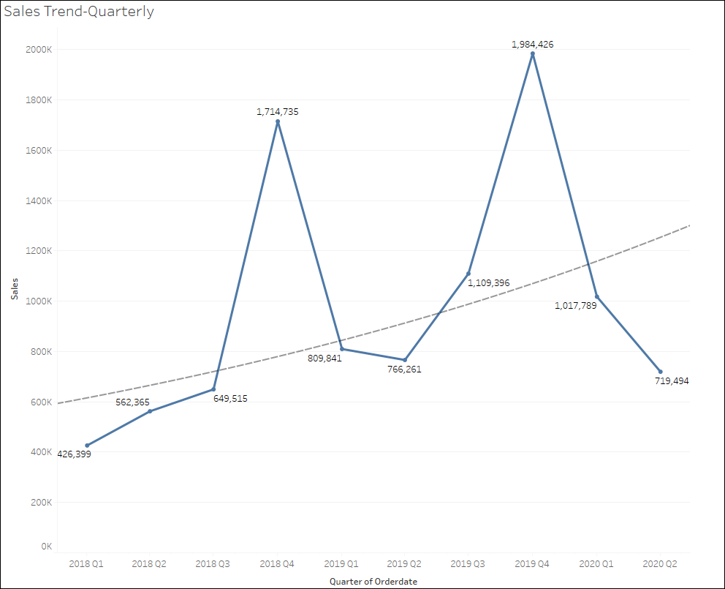
EDA - SALES TRENDS- Yearly & Quarterly
Using Tableau, we derive the yearly and quarterly sales information based on orderdate.
The yearly trend shows a dip towards 2020 as we have data only till 31 May 2020, Hence the trend for 2020 should be ignored. We can see that of the total sales from 2018 to 2020, 34.35% was contributed by 2018 and 47.85% by 2019 which indicates the business is growing.
Lets look at the quarter data.
The quarterly sales data indicates seasonality with Q1,Q2 and Q3 on a steady increase and Q4 with a sharp rise. We should not consider 2020 Q2, as it does not have 2020 June month’s data. We can see that the sales trend is upwards.
27

Slide 28
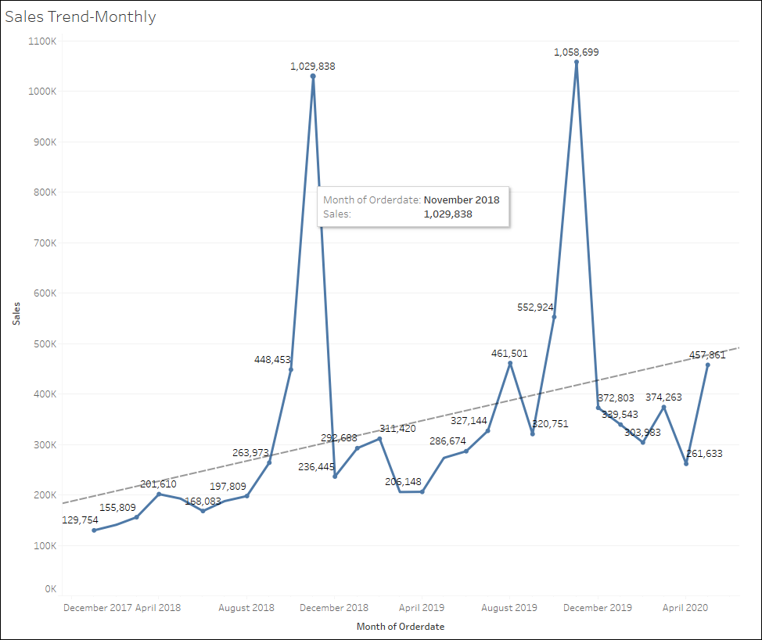
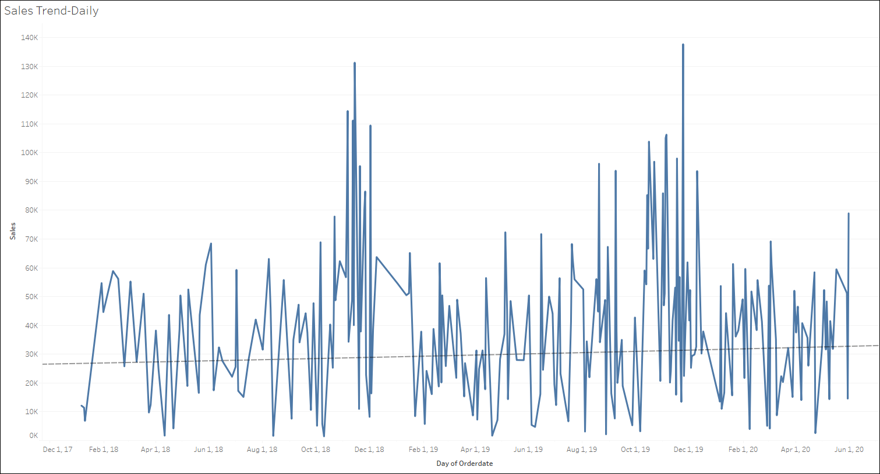
EDA - SALES TRENDS- Monthly & Quarterly
Using Tableau, we derive the monthly and daily sales trend information based on orderdate.
The monthly trend shows a significant uptrend. Seasonality exists in the trend where from January to September the sales rise almost on a linear fashion and it rises exponentially in October and November. The sales fall in December to almost September levels and the pattern repeats.
The trend shows a monthly average sales of 190K in Jan 2018 to 490K in May 2020, which shows a rise of 158% in monthly average sales amount.
Daily trend also shows an uprise in trend as expected, from average of 27k in Jan 2018 to 32k in May’2020 which shows a rise of 18.5% in daily sales value for the period under consideration.
28

Slide 29
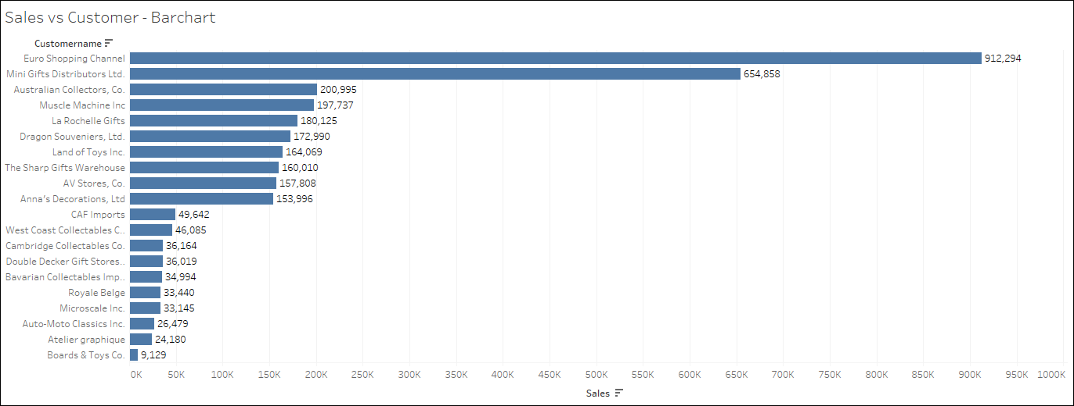
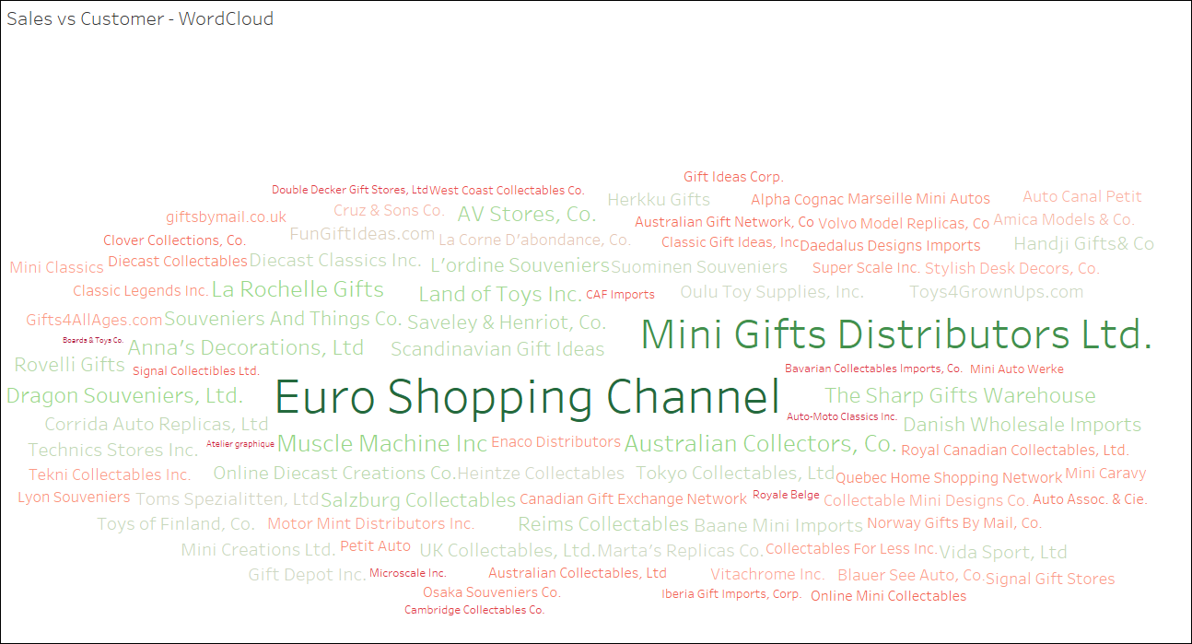
EDA - SALES – Sales vs Customer
Using Tableau, we derive the sales vs customer information.
The bar chart shows the top 10 and bottom 10 customers based on aggregate Sales. Euro Shipping Channel leads the sales with 912,294 followed by Mini Gifts Distributors Ltd with 654,858. Boards & Toys Co is at the bottom of the table with 9129 with the next customer with worst sales, Atelier graphique at 24,180.
The word cloud substantiates the above figures.
29

Slide 30
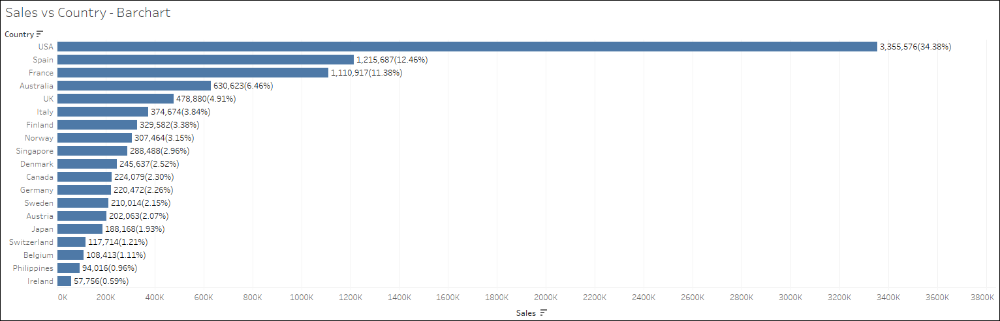
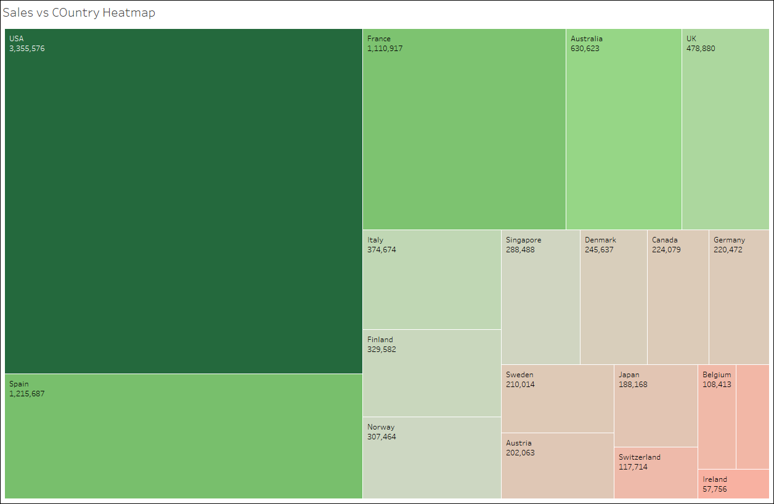
EDA - SALES – Sales vs Country
Using Tableau, we derive the sales vs country information.
The bar chart shows the aggregate sales against country. 58% of all sales is done by customers in the top 3 countries which are USA, Spain & France. Ireland is at the bottom of the sales table with 57,756 at 0.6%.
30

Slide 31

EDA - SALES – Sales vs Dealsize
Using Tableau, we derive the sales vs dealsize information.
We can see that sales with dealsize of “Medium” has the lion’s share which accounts for 60.77% of the total sales. Small deals comes next with 26.33% and Large deals accounts for 12.90% of the sales.
31

Slide 32


EDA - SALES – Sales vs ProductCode
Using Tableau, we derive the sales vs productcode information.
The bar chart shows the aggregate sales against top and bottom 10 product codes. S18_3232 product has the highest sales amounting to 284,249 and S24_3969 is at the bottom of the sales table with value 31,739. The wordcloud corroborates the bar chart data.
32

Slide 33

EDA - SALES – Sales vs ProductLine
Using Tableau, we derive the sales vs productline information.
We can see that sales is maximum in product line Classic Cars which accounts for 39% of total sales, followed by Vintage Cars at 18.51%.
Trains account for the least contribution to sales at 2.32%
33

Slide 34

EDA - SALES – Sales vs MSRP
Using Tableau, we derive the sales vs MSRP information.
We can see that sales has a strong correlation with MSRP, which stands to reason as Sales is a factor of PRICEEACH, which in turn has a direct correlation with MSRP.
34

Slide 35

EDA - SALES – Sales vs Priceeach
Using Tableau, we derive the sales vs PRICEEACH information.
We can see that sales has a strong correlation with PRICEEACH, which stands to reason as Sales is a factor of PRICEEACH.
35

Slide 36

EDA - SALES – Sales vs QuantityOrdered
Using Tableau, we derive the sales vs QuantityOrdered information.
We can see that sales has a strong correlation with QUANTITYORDERED, which stands to reason as Sales is a factor of QUANTITYORDERED.
36

Slide 37
EDA - Inferences
Lets look at the inferences derived from the given dataset.
Sales varies from 482 to 14083 with an average value of 3553 per orderline.
MSRP varies from 33 to 214 with an average value of 101.
PRICEEACH varies from 27 to 253 with an average value of 101. Its interesting to note that we have PRICEEACH higher than MSRP.
Quantity ordered by customers varies between 6 and 97 with an average value of 35.
Sales information comprises of orders from 19 countries. Customers from USA has ordered the maximum number of time, 928. The top 3 countries USA,Spain and France together accunts for 58% of the total number of orders.
Customers from Switzerland, Philippines and Ireland are at the bottom of the frequency of orders accounting for 2% of data.
The dataset has orders from customers residing in 71 different cities. Madrid leads in frequency with 304 orderlines and Charleroi is at the bottom with 8 orderlines.
Among the 3 dealsize, we can see that Medium dealsize leads in frequency with 49% of the data,followed by Small deals at 45.36 and at bottom is Large deals with 5.5%.
The dataset has order information on 109 unique products. Product S18_3232 has the highest frequency with 51all the other 108 product codes vary in frequency between 21 and 28.
There are 7 product lines and Classic Cars have the highest frequency of 949 (34.55%). Trains are the product line with least frequency – 77 (2.8%).
We can see 6 unique Status category and Shipped have the highest frequency of 2741 (34.55%). Disputed status have the least frequency – 14 (0.51%).
We can see strong positive correlation between SALES, PRICEEACH & QUANTITYORDERED, which stands to reason as SALES is calculated from PRICEEACH & QUANTITYORDERED.
We can see strong correlation between MSRP and PRICEEACH (normal market behavior), which in turn leads to strong correlation between MSRP and SALES.
We can see moderate negative correlation between DAYS_SINCE_LAST_ORDER & MSRP/SALES & PRICEEACH. This indicates that customers which make big purchases are less recent.
37

Slide 38
EDA – Inferences (contd..)
QUANTITYORDERED shows almost no correlation with PRICEEACH/MSRP which indicates that the market is stable, and customers are not stocking items, expecting prices to be varied.
In all three types of dealsize –large/medium & small , USA leads in count, followed by Spain and then France ( France(21) has more large deals than Spain – (17)).Switzerland Philippines & Ireland are at the bottom of the table when considering number of deals.
In the top 3 countries with maximum order (USA,Spain & France), we can see that the top 3 product lines are Classic Cars, Vintage Cars and Motorcycles.
The average price is highest for productline Classic cars, followed by Trucks & Buses and then by Motorcycle.
PRICEEACH is higher than MSRP for all productlines except Classic Cars, which shows discounts are provided for Classic Cars but not for other product lines (could be due to import taxes as legally prices should not exceed MSRP).
Across the dataset we have customers ordering the productline Classic Cars maximum at 33,373 (34.61%), followed by Vintage Cars at 20,059 (20.8%) and then 11,080 (11.49%).
The quarterly sales data indicates seasonality with Q1,Q2 and Q3 on a steady increase and Q4 with a sharp rise. We can see that the sales trend is upwards.
The monthly trend shows a significant uptrend. Seasonality exists in the trend where from January to September the sales rise almost on a linear fashion and it rises exponentially in October and November. The sales fall in December to almost September levels and the pattern repeats. The trend shows a monthly average sales of 190K in Jan 2018 to 490K in May 2020, which shows a rise of 158% in monthly average sales amount.
Daily trend also shows an uprise in trend as expected, from average of 27k in Jan 2018 to 32k in May’2020 which shows a rise of 18.5% in daily sales value for the period under consideration.
Among customers, Euro Shipping Channel leads the sales with 912,294 followed by Mini Gifts Distributors Ltd with 654,858. Boards & Toys Co is at the bottom of the table with 9129 with the next customer with worst sales, Atelier graphique at 24,180.
Sales with dealsize of “Medium” has the lion’s share which accounts for 60.77% of the total sales. Small deals comes next with 26.33% and Large deals accounts for 12.90% of the sales.
S18_3232 product has the highest sales amounting to 284,249 and S24_3969 is at the bottom of the sales table with value 31,739.
sales is maximum in product line Classic Cars which accounts for 39% of total sales, followed by Vintage Cars at 18.51%. Trains account for the least contribution to sales at 2.32%
38

Slide 39
Customer Segmentation – RFM Analysis
What is RFM Analysis?
RFM in the RFM analysis stands for Recency, Frequency and Monetary. The analysis aims to quantitatively rank, and group customers based on these 3 parameters.
Recency – is calculated as the most recent order placed by the customer, i.e current date – last order date
Frequency – is calculated as the number of orders placed by the customer in the analysis time period.
Monetary – is calculated as the total sum of sales attributed to customer over the analysis time period.
RFM analysis provides scores to customers based on the above parameters. Business can provide different weights to the parameter, considering the intent of the analysis.
Using these scores, business can classify customers into various clusters, termed as customer segmentation, which in turn helps to run targeted marketing campaigns to entice customers to increase the sales.

Slide 40
RFM – Parameters & Assumptions
RFM analysis will be performed using KNIME analytics platform.
Recency is calculated for each order as max(of all order dates) – order date. Max order date in the given dataset is May 31, 2020, which is used to calculate Recency.
Frequency will be calculated as the number of unique order numbers for a customer, which translates to the number of interaction the customer has with business within the evaluating window.
Monetary will be calculated as sum of Sales amount per customer.
Using KNIME tool, we will segment the customer into 3 bins using quantile values of 0, 0.25, 0.75, 1.0

Slide 41

RFM – KNIME Workflow Image
The KNIME workflow image is provided.
On running the workflow, the output data with RFM values are generated and is attached below.

Slide 42

RFM – Output Head Table

Slide 43
RFM Analysis- Inferences
Based on the different bin values of Recency( R ), Frequency ( F ) and Monetary ( M ), we can consider the below customer segments:
Top Customers – R(3)/F(2-3)/M(2-3). These are customers who have shopped recently, are frequent and make high value purchases.
Loyal Customers - R(3)/F(1)/M(1-3) & R(3)/M(1)/F(1-3) & R(2)/M(2-3)/F(1-3). These are customers who shop regularly and provide regular revenue stream to business.
Churn Risk Customers - R(2)/F(1-3)/M(1) & R(1)/F(3)/M(1-3) .These customers haven’t done any sales recently, but used to frequent and some did large deals.
Lost Customers - R(1)/F(1-2)/M(1-3). These are customers who were infrequent and have not done any business in recent time.
Recency | Monetary | Frequency
 |  | 1 | 2 | 3
1 | 1 | Lost Customers
 | 2
 | 3
2 | 1 |  |  | Churn
 | 2 | Loyal
 | 3
3 | 1
 | 2 |  | Top
 | 3

Slide 44

RFM Analysis- Inferences (contd..)
The RFM analysis excel from KNIME is fed into python and we create a crosstab for RECENCY, MONETARY and FREQUENCY.
Based on the mapping on the chart on the left we can identify the customers in various segments.
Recency | Monetary | Frequency
 |  | 1 | 2 | 3
1 | 1 | Lost Customers
 | 2
 | 3
2 | 1 |  |  | Churn
 | 2 | Loyal
 | 3
3 | 1
 | 2 |  | Top
 | 3

Slide 45

RFM Analysis- Best Customers
We have seen the RFM values for top customers as – R(3)/F(2-3)/M(2-3). These are customers who have shopped recently, are frequent and make high value purchases. Please find below some of the customers falling into this segment:

Slide 46

RFM Analysis- Customers on the verge of Churning
We have seen the RFM values for churn customers as – R(2)/F(1-3)/M(1) & R(1)/F(3)/M(1-3) .These customers haven’t done any sales recently, but used to frequent and some did large deals. Please find below the customers in this segment.

Slide 47

RFM Analysis-Lost Customers
We have seen the RFM values for lost customers as - R(1)/F(1-2)/M(1-3). These are customers who were infrequent and have not done any business in recent time. Please find below the customers in this segment.

Slide 48

RFM Analysis-Loyal Customers
We have seen the RFM values for loyal customers as - R(3)/F(1)/M(1-3) & R(3)/M(1)/F(1-3) & R(2)/M(2-3)/F(1-3). These are customers who shop regularly and provide regular revenue stream to business. Please find below some of the customers in this segment. Please find below some of the customers in this segment.

Slide 49


